Slide 1


CH GROCERS
L5 Section-B Epsilon Web Developers
Bibhas Shrestha (Team Leader)
Srijan Thapa
Abhash Niroula
Manoj Chhetri

Slide 2
Team and Topic
Team Members (Speaker) | Time | Topic
Abhash Niroula | 2 minute | Project Justification and Introduction about website
Manoj Chhetri | 2 minute | Belbin Analysis, Project Plans and Policies
Bibhas Shrestha | 2 minute | Project Charter and Work Breakdown Structure
Srijan Thapa | 2 minute | Use-Case Diagram and ERD

Slide 3
Project Justification
It supports 10 shops.
Website responsive. Compatible on both different browsers like mobile, desktop browsers.
Payment method is via PayPal system.
Trader can manage their shop.
Secured against common security threats.
Consumer can place the order 24/7.
Admin login is mandatory to access trader accounts.

Slide 4
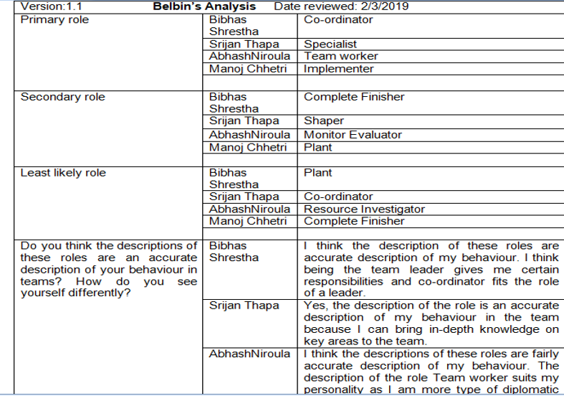
Belbin Analysis

Slide 5
Project Plans and Policies
With the purpose of growing online business to compete with the chain stores, the trader from Checkhuddersfax wants to market their business through online.
There will be three interface - Customer, Trader and Admin.
The purpose is to make website user friendly.
The purpose of e-commerce is also promising the trader to sell their product without sacrificing their family time.
Customer convenience is one of the priority to the project.
Local products are highly encouraged.

Slide 6

Project Management
Includes
MS Project

Slide 7
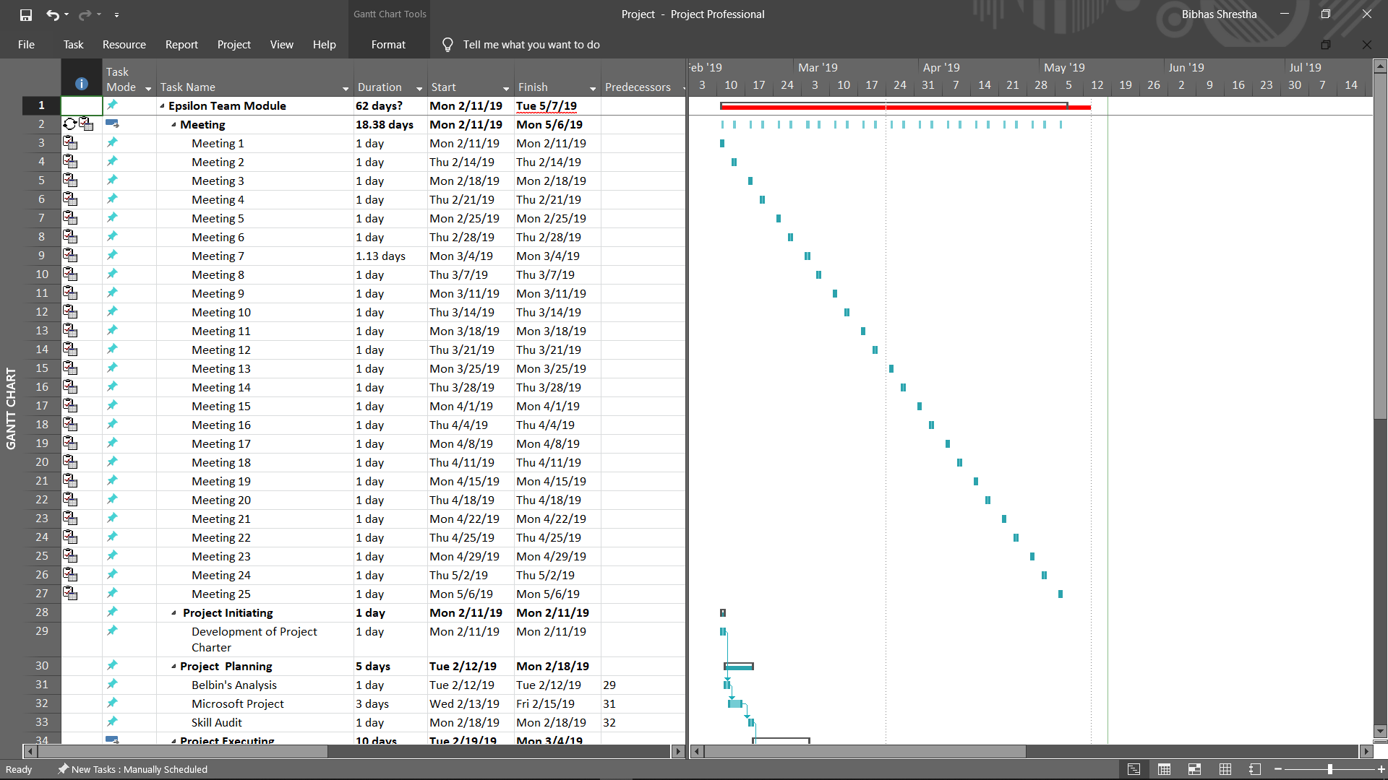
Gantt chart

Slide 8
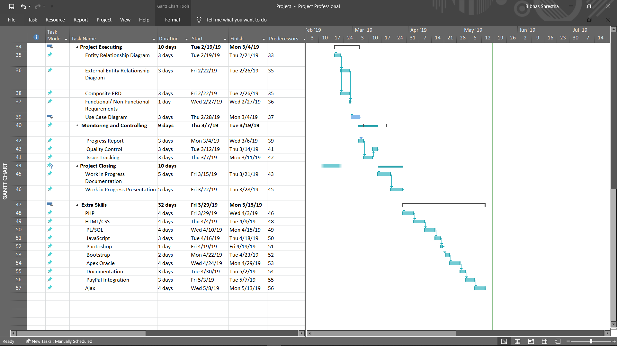
Gantt chart

Slide 9
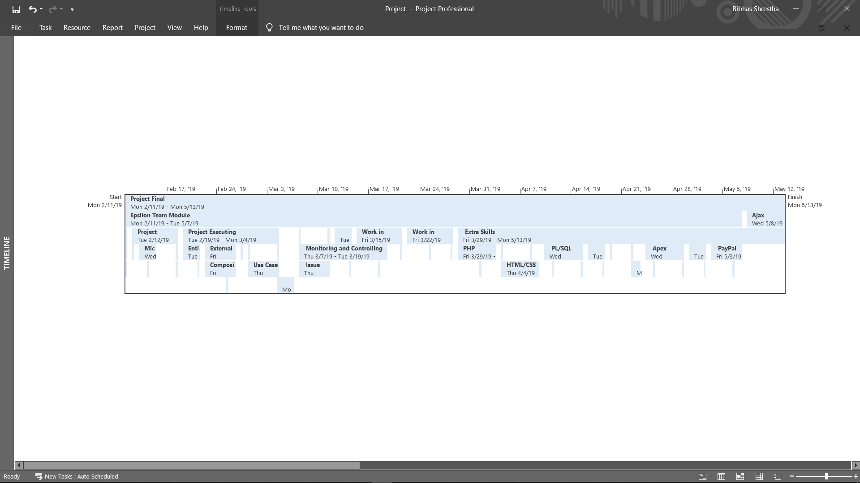
Timeline

Slide 10
Project Design
Includes
EERD
Composite ERD
Use case Diagram
Wireframe

Slide 11
EERD

Slide 12
COMPOSITE ERD

Slide 13
Use case Diagram- overview

Slide 14
Website Demo
Now we will be commencing the website demo

Slide 15
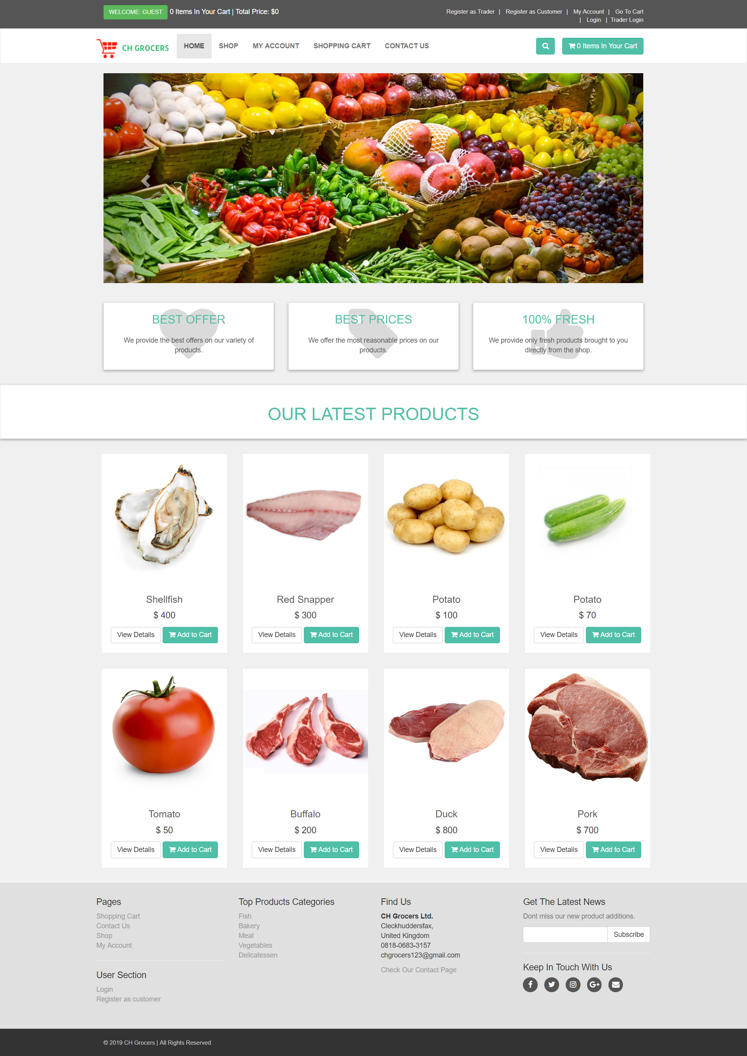
Website Homepage

Slide 16
THE END

